Slide 1
Music generation with GANs
Presenter: Yuxuan Liu; Xiaodong Huo
4/28/2020
Notes:
I’ve asked my team to come up with a few updates in various areas for this presentation. Rather than standing in the front of the room talking at you, we wanted to use this time as more of an open forum from our seats.
I have 3 slides that I want to go over quickly.

Slide 2
Outline
Generating Music with GANs
Introduction
Approaches
Our Implementations
Results
Future Works

Slide 3
Motivation
Introduction
Tools to help music creation
Give artist inspirations about composition and melody
Empowers non-musical people to make music
People like us
Create copy right issue free music for content video and game creators
Possibly profit

Slide 4
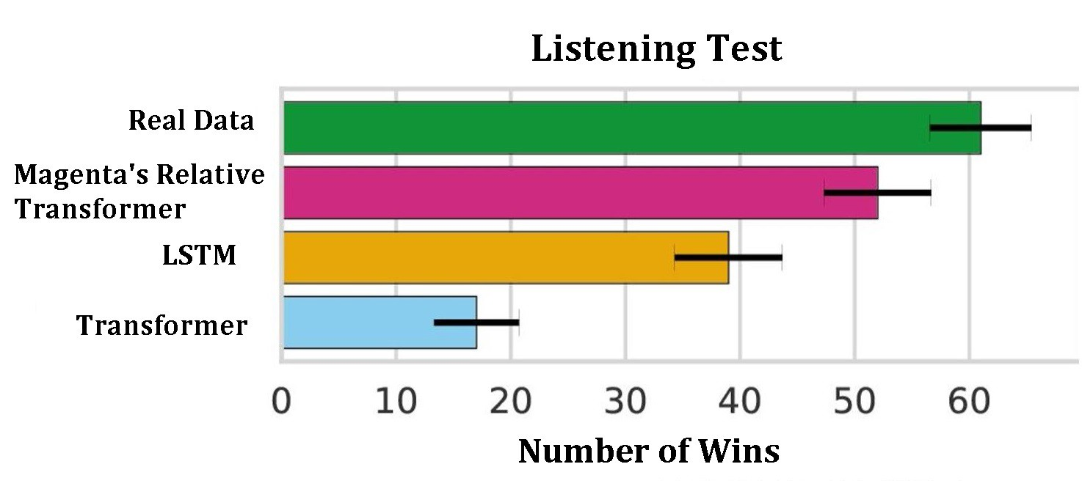
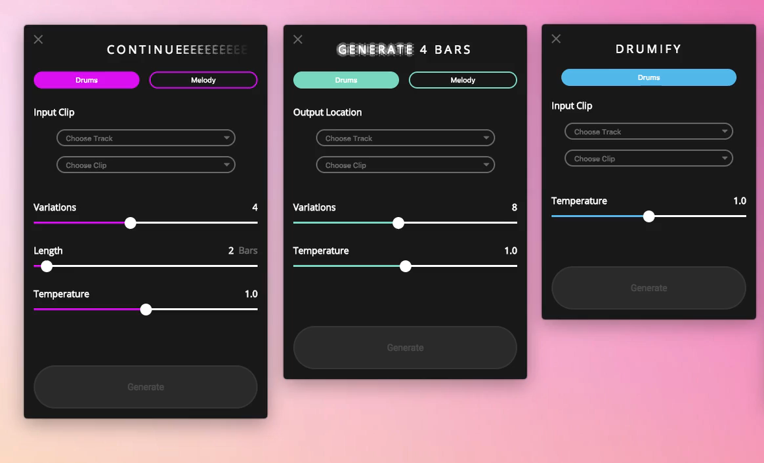

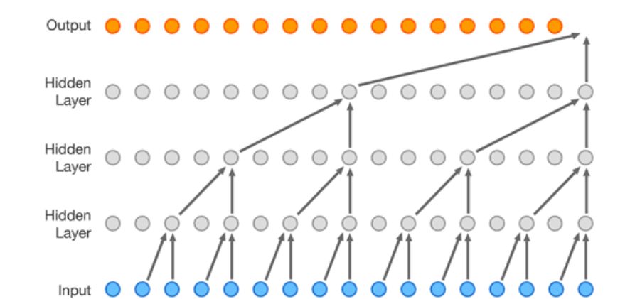
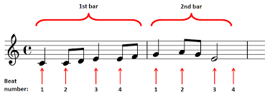
State of art
Approaches
Simple LSTM
Magenta — 2016
MuseGAN — 2017
Wavenet — 2016
MuseNet — 2019
Magenta Studio
Notes and bars
Wavenet

Slide 5
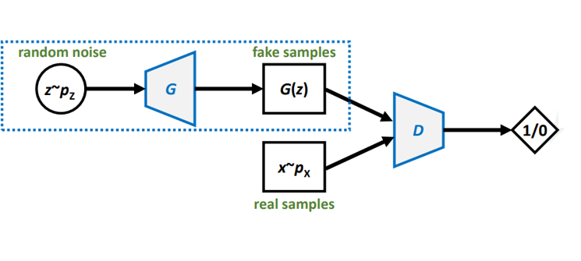
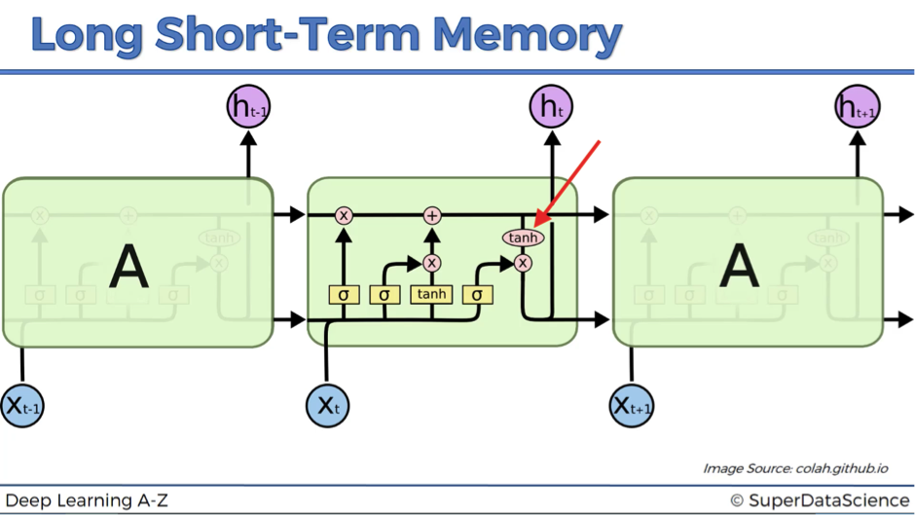
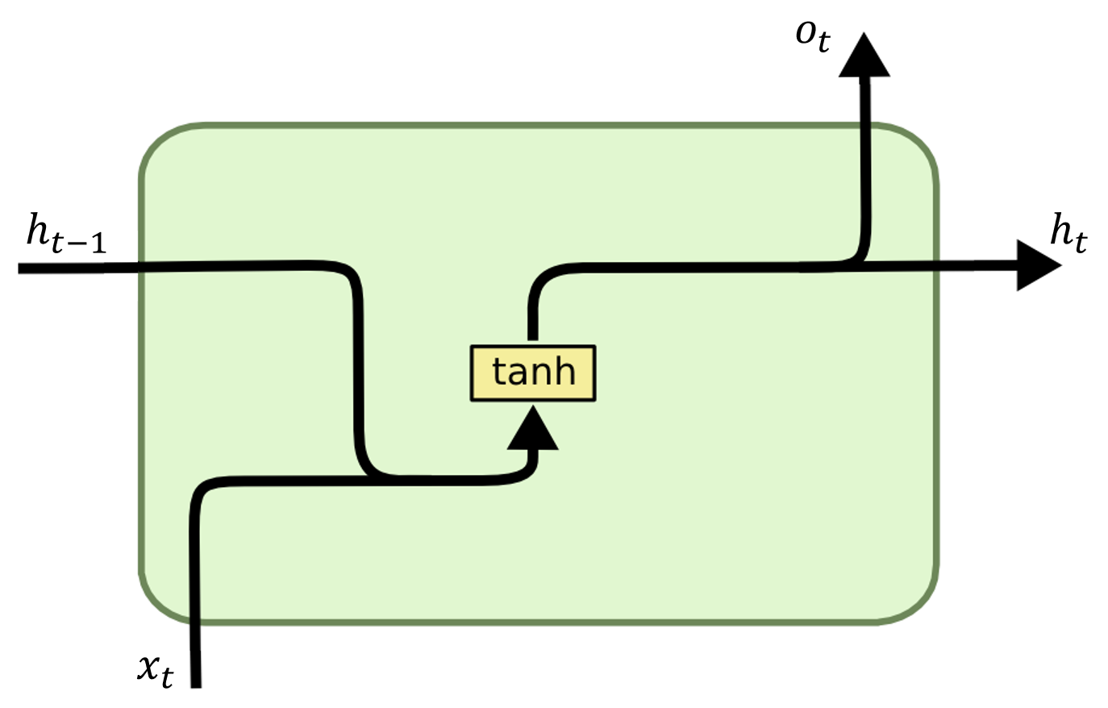
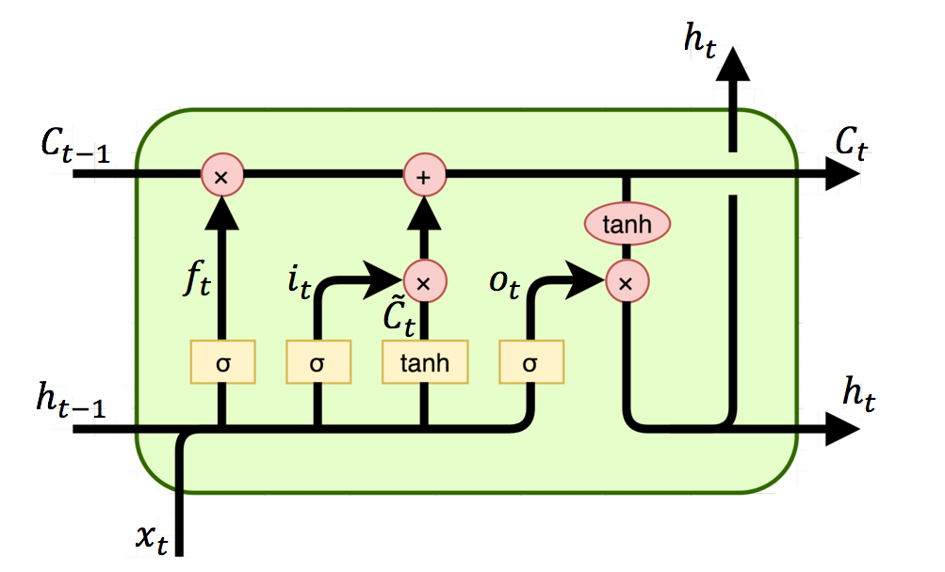
Implementation building blocks
Approaches
GAN
Generator G
Discriminator D
RNN-LSTM D
CNN G
GAN/LSTM/CNN
GAN
RNN-LSTM
RNN
LSTM
Notes:
• VAE: variational autoencoder • GAN: generative adversarial network

Slide 6
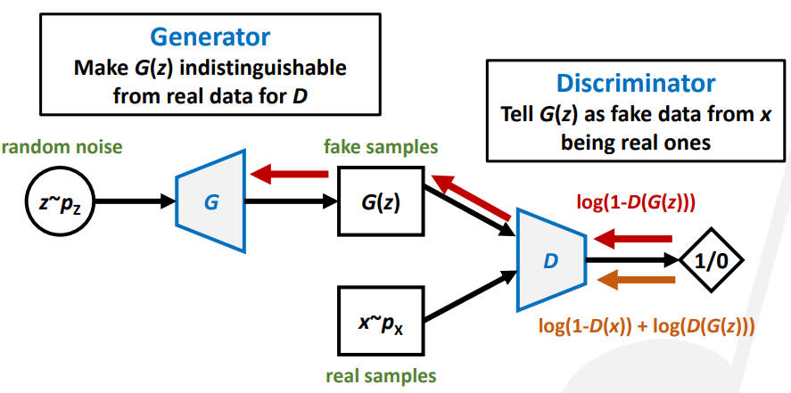
Loss Function and backpropagation
Approach
GAN
Forward Path
Back Propagation

Slide 7
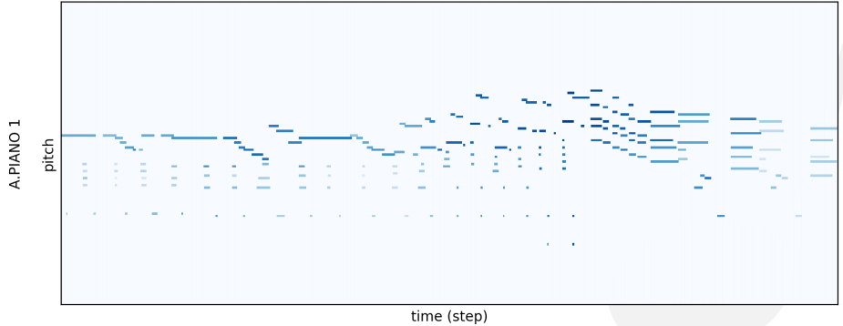
Training data set
Approach
Our Choice
Piano rolls(imagelike)
MIDI events (test-like)
200 hours of virtuosic piano performances formatted in MIDI
Piano rolls
Size: 96 x 128 x M:
96 =num_beat * bars
128 = C-1 to G9 128 total possibilities
M: number of piano rolls
Processing using Mido, sequences of messages
{
<message note_on channel=1 note=60 velocity=64 time=0>
<message note_on channel=2 note=50 velocity=20 time=1>
<message note_on channel=2 note=60 velocity=30 time=2>
}
https://salu133445.github.io/lakh-pianoroll-dataset/representation
https://magenta.tensorflow.org/datasets/maestro

Slide 8
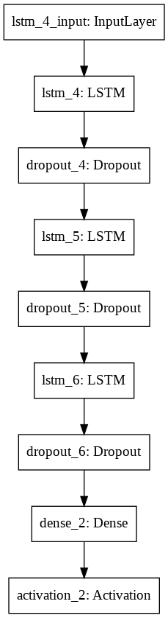
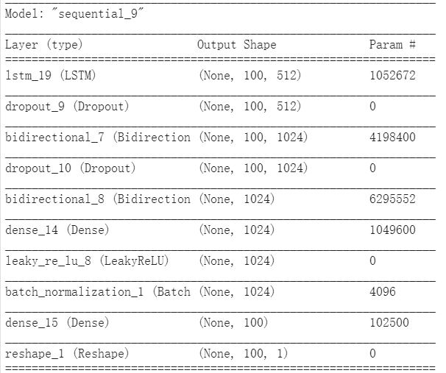
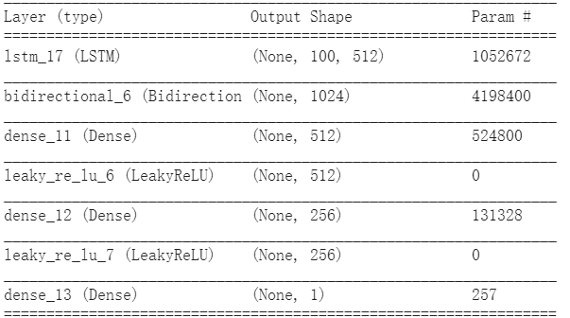
Model designs
Our Implementations
Random Vector：
Training Sound
Naive Approach , Simple Lstm
Generator
Discriminator
Single Key
Out

Slide 9
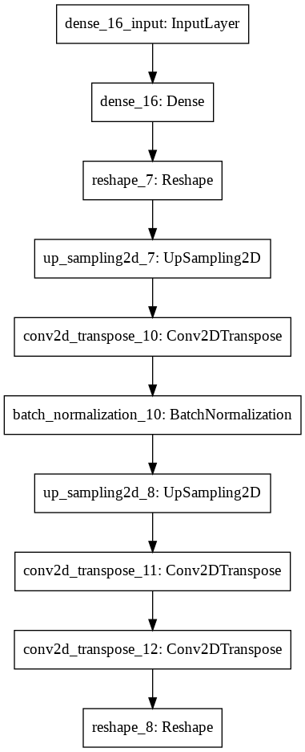
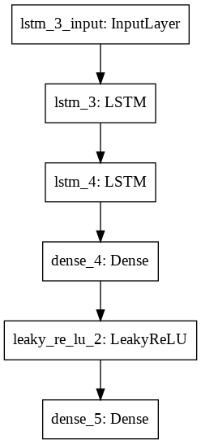
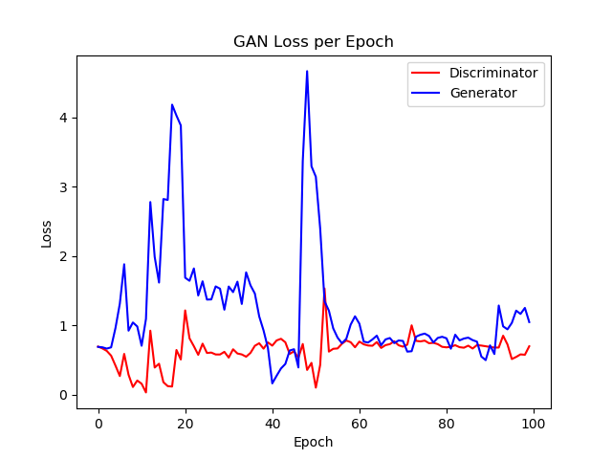
CNN-GAN Music Generation Model
Introduction

Slide 10
Future Work
Result
Improve the stability of network
Multiple instruments music
Standardized test dataset and evaluation metrics to replace subjective evaluation

Slide 11
References
Introduction
https://salu133445.github.io/ismir2019tutorial/
https://towardsdatascience.com/neural-networks-for-music-generation-97c983b50204
https://towardsdatascience.com/generating-pokemon-inspired-music-from-neural-networks-bc240014132
https://deepmind.com/blog/article/wavenet-generative-model-raw-audio

